Slide 1
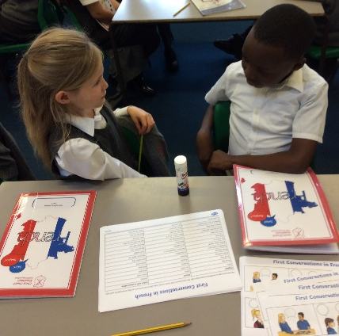
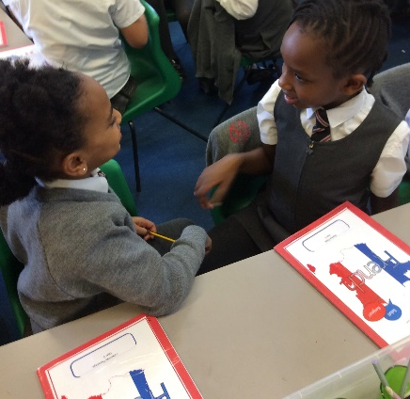
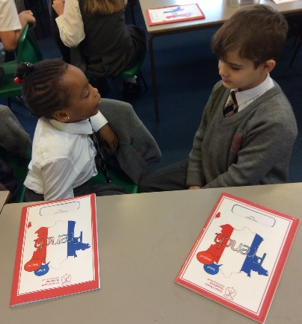
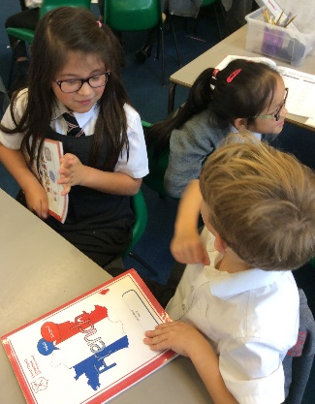
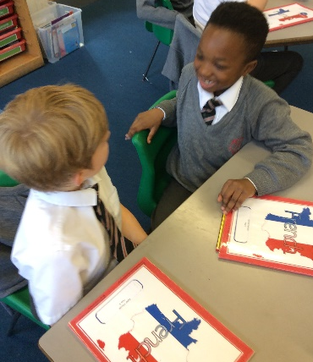
Monday 3rd October 2019 LO: I can verbalise French greetings
Hello → _________________
Goodbye → _______________
How are you? → ___________________
Today we started our French topic by learning about French greetings. We then turned to the person next to us to practice these greetings

